Slide 1
Bacteriorhodopsin (Part III)
Its Potential in Technical Applications

Slide 2
Photochromic Applications
Isomerization from all-trans to 13-cis is the first occurrence after the photochemical excitation of bacteriorhodopsin.
This causes significant transient shifts in the absorption spectrum.
Change in isomerization and deprotonation of the chromophoric group is observed.
In the L to M transition, deprotonation occurs from the Schiff base nitrogen group to Asp85 causing a drastic blue shift of the absorption to 410 nm.

Slide 3
Photocycle of bacteriorhodopsin.
Upon absorption of a photon, the initial B-state of bacteriorhodopsin is converted photochemically to the J-state from where a series of thermal steps leads back to the initial state. The proton transport is intimately coupled to the photocycle, which is observed as a sequence of intermediates which are represented by the common single-letter code with their absorption maxima given as subscripts. In the dark, bacteriorhodopsin relaxes thermally to the D-state which has 13- cis configuration. The resulting mixture of B- and D-states is called dark adapted bacteriorhodopsin. From the O-state, a photochemical conversion of all-trans to 9-cis retinal is possible which is not thermally reisomerized to the initial state.
The proton transport and related retinal configurations as well as accessibility of the nitrogen in the Schiff-base linkage between retinal and Lys216 are indicated. This sequence represents several of the molecular changes involved in the proton transport.

Slide 4
Photochromic Applications
The photochromism of bacteriorhodopsin is dominated by the intermediate which has the longest life-time.
This forms a “bottleneck” in the photocycle.
The anisotropy of the retinylidene groups causes excitation of a random distribution of PM patches with polarized light (Figure A).
Further, causing the chromophores to become oriented in parallel to the actinic light polarization and a preferentially converted anisotropy is obtained (Figure B).

Slide 5
(B) Upon illumination with polarized light, the retinylidene residues which are in parallel to the electric field vector of the actinic light are preferentially excited and isomerized.
(A) The retinylidene residues are strongly anisotropic.

Slide 6
Photochromic Applications
In solutions containing PM this is masked by diffusion.
In bacteriorhodopsin-films where the PM patches are fixed, the photoinduced anisotropy can be easily observed and utilized.
Three types of photochromic changes in bacteriorhodopsin :
The photochromic shift between the B and M states - Optical processing tasks (Figure C).
9-cis-containing states of blue membrane or suitably modified BR-variants - Photoerasable data storage (Figure D).

Slide 7
(C) Transient photochromic change of bacteriorhodopsin between the initial purple state and the yellowish M-state (middle).
(D) The photochemical formation of 9-cis retinal may be utilized for photochromic long-term storage.

Slide 8
Photochromic Applications
3) Permanent photochromic changes obtained through two-photon absorption in bacteriorhodopsin - Long-term data storage (Figure E)
Permanent storage of information in bacteriorhodopsin.

Slide 9
Preparation of Bacteriorhodopsin Films
Optical films are prepared from bacteriorhodopsin by polymer embedding.
Optically clear and water-soluble polymers are suitable (e. g., polyvinylalcohol, gelatin)
The film formation is usually carried out by mixing the polymers with PMs and additives in aqueous solution casted on a glass support.
Usually dried in air to remove water.
The films may also be sealed with a second glass plate.

Slide 10
Interfacing the Photochromic Changes
Ease of implementation of the interface between the bacteriorhodopsin films and any type of optical system.
The bacteriorhodopsin film is completely sealed, the only interface being the light which transports energy and information simultaneously.
Applications :
Photochromic colour classifier: the use of bacteriorhodopsins with different absorption maxima would allow a biomimetic system for color perception to be set up.

Slide 11
Interfacing the Photochromic Changes
Photochromic inks: These inks differ from the polymer films for optical recording by their rheological properties. Depending on the method of application (e. g., screen printing, offset printing), the viscosity and surface tension must be considered.
Electrochromic inks : The main color shift in bacteriorhodopsin is due not to a primary photochemical reaction but to the protonation change of specific groups. As protons are charged particles, their removal from the binding position by electric fields is possible.

Slide 12
Interfacing the Photochromic Changes
Photochromic inks:
Examples of photochromic inks made from bacteriorhodopsin are shown in Fig C, with the initial colored (purple) and bleached, yellowish inks in the foreground and background, respectively.

Slide 13
Interfacing the Photochromic Changes
Photochromic photographic film: Permanent bleaching of bacteriorhodopsin may be achieved with hydroxylamine.
The chemical reaction of hydroxylamine with the retinal binding site occurs in an intermediate state only.
No reaction of BR in the B-state is observed. With this, it is possible to fabricate nonreversible optical films from bacteriorhodopsin.
Long-term photorewriteable storage of information : In blue membrane, a photochemical conversion from all-trans to 9-cis retinal, which appears pink in bacteriorhodopsin, may be induced by high light intensities.

Slide 14
Interfacing the Photochromic Changes
Neural networks : Bacteriorhodopsin is also a suitable material for neural networks because its absorption state may be shifted with blue and yellow light in different directions.
3-D information storage : Bacteriorhodopsin shows an astonishingly high two-photon absorption cross-section of the initial B state.
Can be used in a two-photon absorption set-up to address the absorption state of bacteriorhodopsin in three dimensions.
Advantage of such a memory device is its tolerance towards electromagnetic radiation.

Slide 15
Interfacing the Photochromic Changes
3-D information storage :
An ID card sample with a bacteriorhodopsin-based optical storage in the purple-colored strip is shown in Fig D

Slide 16
Interfacing the Photochromic Changes
Nonlinear optical filtering: the nonlinear optical response of bacteriorhodopsin towards the incident light intensity
image processing purposes (e. g., edge enhancement, noise reduction)
The response curve of the bacteriorhodopsin can be tuned over several orders of magnitude by changing the lifetime of the M-state.
Can be accomplished by: changing the pH, or by using modified bacteriorhodopsins.

Slide 17
Interfacing the Photochromic Changes
Holographic pattern recognition and interferometry: applications include
a holographic real-time correlator (Fig A)
a holographic camera for nondestructive testing (Fig B).

Slide 18
Photochromic applications of bacteriorhodopsin. (A) Holographic correlator; (B) holographic camera for interferometric testing;

Slide 19
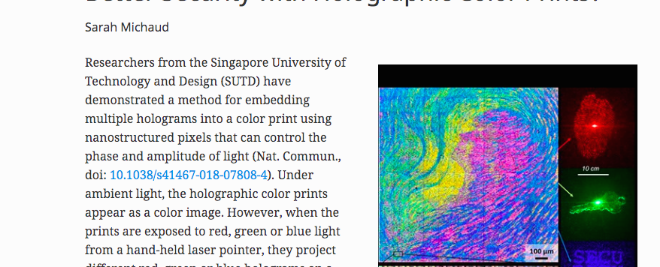
Holographic pattern

Slide 20
Outlook
Bacteriorhodopsin is today the biological photochromic material for which technical applications in optical information processing are much more developed than for any other biomaterial.
Biomaterials as blueprints for technical materials with nanoscale functions form the basis of the concept of nano bionics and bacteriorhodopsin was the first such example.

